Slide 1
Unit Test The Big Picture

Slide 2








What will you learn?
The state of unit testing
The goal of unit testing
Consequences of having a bad test suite
Using coverage metrics to measure test suite quality
Attributes of a successful test suite

Slide 3
Current state of Unit Testing

Slide 4


Slide 5
Past two decades
Mandatory in most companies
Most programmers practice unit testing

Slide 6
Also, in those two past decades
Doesn’t provide the result
New bugs constantly appear
Doesn’t seem to mitigate the situation at all.

Slide 7
Enable sustainable growth of the software project.”
‘‘

Slide 8
Dynamics between projects with and without tests
Works hour spent
Without Test
Software Entropy
With Test
Progress

Slide 9

Software Entropy
The amount of disorder in a system
Coding
Code change
Without proper care
Fixing one bug introduce another bug

Slide 10
Overturning using Tests Unit Tests help overturn this tendency, How?
Act as a safety net
Helps to make sure the existing functionality works
Provides insurance against majority of regression

Slide 11
Regression
When a feature stops working as intended after a certain event
Regression and software bug are synonyms

Slide 12
Downside of doing unit tests
Effort
Effort
Significant Effort

Slide 13
What makes a Good or Bad Test?

Slide 14
Not all tests are created equal.”
‘‘

Slide 15
Bad Tests
Raises false alarm
Doesn’t help to catch regression errors
Slow and difficult to maintain

Slide 16
Dynamics between projects with and without tests
Works hour spent
Without Test
With Bad Test
With Good Test
Progress

Slide 17
Upkeep cost
up·keep /ˈəpˌkēp/ noun - the process of keeping something in good condition.
Refactoring the test when you refactor
Running the test on each code change
Dealing with false alarms raised by the test
Spending time reading the test

Slide 18
Code is a liability not an asset.”
‘‘

Slide 19
More of this in Session 4

Slide 20

Coffee Time 15mins.

Slide 21
Coverage metrics

Slide 22
Coverage Metric shows how much source code a test suite executes, from none to 100%.

Slide 23
Two popular coverage metrics
Code Coverage
Branch Coverage

Slide 24

Coverage metrics are a good negative indicator but a bad positive one
Little Coverage
100% coverage
Good indication that we are not testing enough
Not guaranteed having a good-quality test suite.

Slide 25
Code Coverage metric

Slide 26
Code coverage metric
Also known as test coverage
Ratio of the number of code lines executed and the total number of lines in your code base
Lines of code executed Total number of lines
Code coverage (test coverage) =

Slide 27
Understanding the code coverage metric
Covered by the test
Sample Method
Refactored
Not covered by the test
Number of lines executed 4
= 0.8 = 80%
Number of lines executed 3
= 1.0 = 100%
Total Number of lines 5
Total Number of lines 3

Slide 28
Branch Coverage metric

Slide 29
Branch Coverage metric
Ratio of the number of code branches used by the test suite and the total number of branches
Focuses on control structures, such as if and switch statements
Branches Traversed Total number of branches
Branch Coverage =

Slide 30


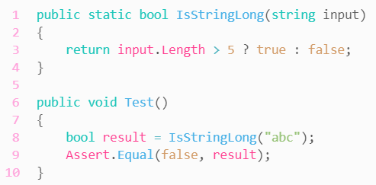
Understanding the branch coverage metric
Start
Length > 5
Length <= 5
End
Branches traversed 2
= .5 = 50%
Total Number of branches 4

Slide 31
Problems with coverage metric

Slide 32
Problems with coverage metrics
Can’t guarantee that the test verifies all the possible outcomes of the system under test
No coverage metric can consider code paths in external libraries

Slide 33
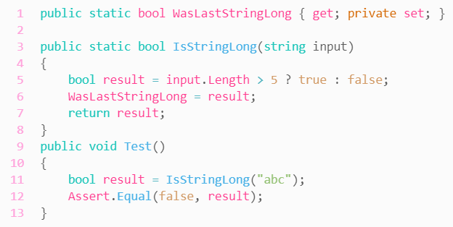
1. Can’t guarantee that the test verifies all the possible outcomes
Need to check that the outcome the system under test produces is the exact outcome you expect it to produce
First outcome
Second outcome
Test verifies only the second outcome

Slide 34
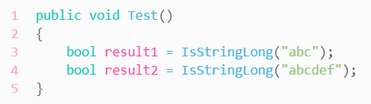
Assertion-free testing
Writing test that don’t have any assertion statements.
Returns true
Returns false

Slide 35
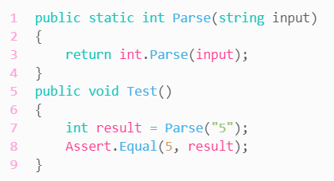
2. No coverage metric can take into account code paths in external libraries
Doesn’t consider the code paths the .NET Framework’s int.Parse method may go through.
Start
int.Parse
Hidden Parts
null
“”
“5”
Not an int
End

Slide 36
Aiming at a particular coverage number

Slide 37
Aiming at a particular coverage number
Best way to view a coverage metric is as an indicator, not a goal
Example:
Below 60% = sign of trouble

Slide 38
Successful test suite

Slide 39
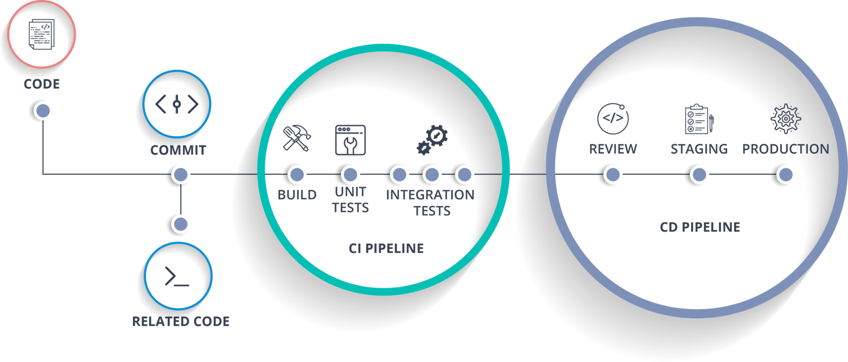
It’s integrated into the development cycle
Should be executed on every code change, even the smallest code

Slide 40
It targets only the most important parts of your code base
Business logic
Domain Model
Testing the business logic gives you the best return of investment
Other Parts
Infrastructure code
External services dependencies
Code that glues everything together

Slide 41
It provides maximum value with minimum maintenance costs
Recognizing a valuable test
Recognizing a test of low value
Writing a valuable test

Slide 42
Assignment
Instructions:
1. Download the assignment source code here: Assignment1.zip
2. Create a folder "Session1".
3. Extract the zip file into Session1 folder.
4. Include Session1 into git repo.
5. Create a Test Project under the same solution
6. Install the following Nuget Package: (If not yet installed) - Xunit - XUnit.Core - XUnit.Analyzers - Xunit.Runner.VisualStudio - Moq - FluentAssertions
7. Create a unit test function for creating/adding new employee (CreateEmployee) - Should validate that the result is not null or empty. - Should validate that the result is not 0
8. Create a unit test function for getting employee with specific id (GetEmployeeById) - Should validate that the result is not null or empty - Should validate that the result has first name - Should validate that the result has middle name - Should validate that the result has last name
9. Create a unit test function for getting all employees (GetEmployees) - Should validate that the result count is greater than 0 - Should validate that the first entry has first name - Should validate that the first entry has middle name - Should validate that the first entry has last name
10. Provide the PR Link Here (Use your cognizant id when accessing this form): https://forms.office.com/r/aFms6fm6rN​

Slide 43
Thank you
Wilfred Nyan P. Dugang
Wilfrednyan.dugang@softvision.com

